Slide 1

KIET GROUP OF INSTITUTIONS
(Affiliated to Dr. A. P. J. Abdul Kalam Technical University, Lucknow, U.P., India)
Ticketless Entry System
TO MONUMENTS AND MUSEUMS

Slide 2
TEAM MEMBERS
Ayush Chauhan 8A
Ashutosh Sharma 8A
Ashmita Kumari 8A
Chiranjeev Patel 8A
Project Guide : Shruti kumari

Slide 3
Problem Statement
Efficient crowd management in museums and heritage sites is crucial for ensuring a seamless and satisfying visitor experience. Traditional paper-based ticketing systems are increasingly inadequate, leading to congestion, long queues, and operational bottlenecks that negatively affect visitor satisfaction and facility management. To overcome these challenges, there is a pressing need for the implementation of a modern, QR-based ticketing system that streamlines visitor entry, reduces waiting times, and enhances operational efficiency. Additionally, this digital solution lays the foundation for potential future integration of advanced predictive analytics, enabling accurate crowd forecasting, better resource allocation, and more personalized visitor experiences. Such comprehensive advancements will ultimately lead to significantly improved crowd management and visitor satisfaction at museums and heritage sites.

Slide 4
Introduction
Ticketless is an online e-ticketing web application that allows users to easily book tickets. In a rapidly changing world, digitization and technology play important roles in our daily lives. Technology incentivizes the delivery of time- and cost-effective products. Implementing digitization in the public visitor system could prove to be more profitable. India ranks second globally in the use of mobile devices, websites, and cloud databases, which helps make public visits more efficient and effective. Most mobile phone users prefer websites over other options for short operations, making this concept suitable for the needs of most users. Many sites published each year can store visitor information in a cloud database, allowing for easy searching and efficient processing. The main idea behind this approach to the web is to serve people by providing a user-friendly and hassle-free interface. This website allows for safe and easy control of museum visitors, eliminating the need for employees to participate in ticket verification.

Slide 5
Efficiency
Quick and hassle-free access for visitors.
Versatility
Compatible with various platforms and devices.
Why QR Codes?
Security
Resistant to counterfeiting and tampering.
Cost-effectiveness
Eliminates the need for printing and distribution of physical tickets.

Slide 6
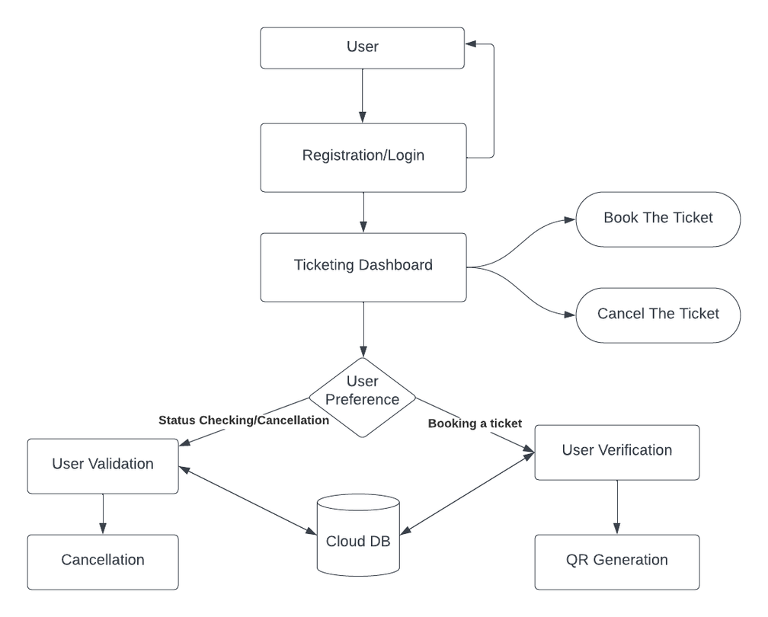
System Architecture
Overview of the software components required for the QR-based ticketing system.

Slide 7
Visitor
Registration/Login
Booking Tickets
Visitor Journey
Accessing Electronic Tickets
Receipt and Confirmation
Payment Process
Entry to the Museum/Heritage Site
Ticket Expiry and Penalty

Slide 8
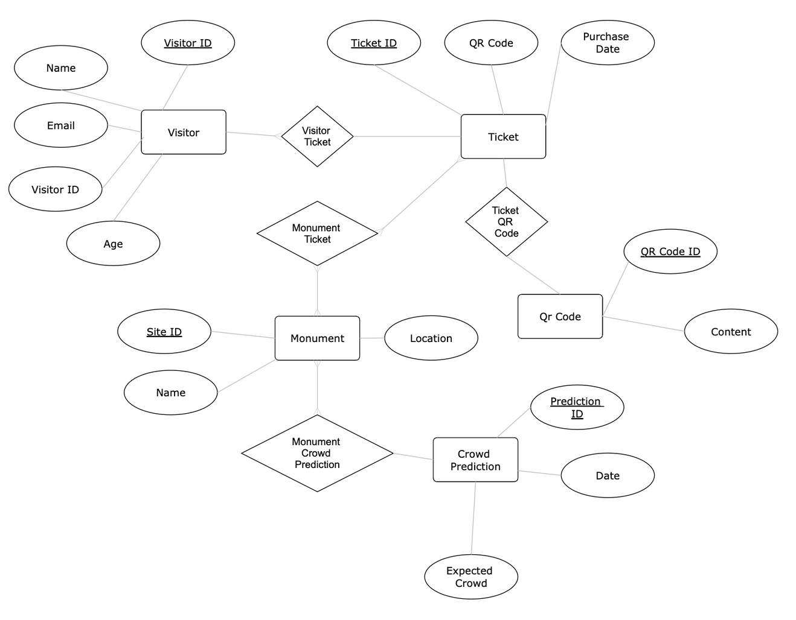
Record Keeping
The ER diagram illustrates the relationships between entities such as Visitors, Tickets, Museums/Heritage Sites, and potential Crowd Predictions.

Slide 9
Future Machine Learning Perspective
Machine Learning Algorithm: Random Forest:
Train the Random Forest model using historical visitor data and external parameters as features. Then, utilize the trained model to predict crowd levels for future dates and times
Dataset Requirements
Timestamped visitor counts form essential data for training machine learning models to predict daily crowd density. By analyzing patterns in past visits, these models forecast future visitor numbers, aiding in efficient resource allocation and crowd management strategies.

Slide 10
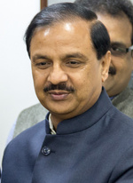
Sales Improvement
“We have provided point of sale (POS) devices at all the tourist sites in the country for e-ticketing to provide the facility of cashless purchase of tickets. The tourists are being encouraged to purchase tickets with cashless transactions,” said Mahesh Sharma, Union Minister of State (Independent) for Tourism and Culture.
Convenience
Increased Reach
Visitors can easily purchase tickets online or via mobile app.
Attracts a wider audience beyond local visitors.
Accessibility
Flexibility
24/7 availability enables ticket purchases anytime, anywhere.
Allows visitors to plan visits according to their schedule.

Slide 11
Statistics
10%
The World Tourism Organization (UNWTO) highlighted that e-ticketing contributed to a 10% increase in revenue for cultural attractions in some regions.
85%
According to a survey conducted by Deloitte, 85% of visitors prefer using e-ticketing systems due to their convenience and ease of use.
580M
in 2020, the revenue from online ticketing services across India was forecasted to amount to around 580 million U.S. dollars.

Slide 12
Technology Used
Web Application: NextJS/React | Styling: ShadcnUI/TailwindCSS
Authentication: Next Auth | Database: PostgreSQL/Supabase
Payment Gateway: Razorpay | Caching: Redis

Slide 13
SDG Mapping
SDG 9 – Industry, Innovation, and Infrastructure
SDG 12 – Responsible Consumption and Production
Build resilient infrastructure and spark inclusive innovation to power sustainable growth.
Ensure sustainable consumption and production patterns to protect resources for future generations.
SDG 11 – Sustainable Cities and Communities
SDG 13 – Climate Action
Take urgent action to combat climate change and its impacts through awareness, adaptation, and innovation
Make cities inclusive, safe, resilient, and sustainable for all to thrive.

Slide 14
Conclusion & Next Step
Achieving Visitor Efficiency
AI and Predictive Features:
The Ticketless web application streamlines the ticketing process, ensuring a seamless and efficient experience for museum visitors.
Integrate AI technologies to enhance predictive features, providing real-time crowd predictions, personalized recommendations, and an even more tailored visitor experience.
Cost Savings and Resource Optimization
Blockchain for Transparency:
By embracing digitization, we unlock the potential for significant cost savings and optimize resource utilization, making public visits more sustainable.
Explore the implementation of blockchain technology to enhance transparency and trust in ticket transactions, ensuring an immutable record of each visitor's journey.
Enhanced User Trust
Augmented Reality (AR) Integration:
The user-friendly interface and secure visitor control instill trust, contributing to a positive perception of the Ticketless platform.
Investigate the integration of AR features within Ticketless to offer immersive experiences for visitors, creating a bridge between the physical and digital realms.

Slide 15
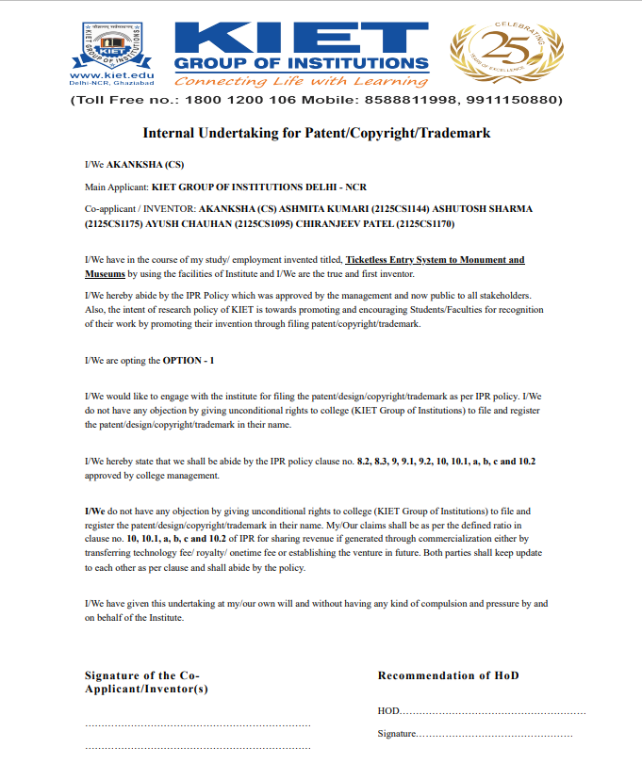
patent
status

Slide 16
Thank you!

